Slide 1
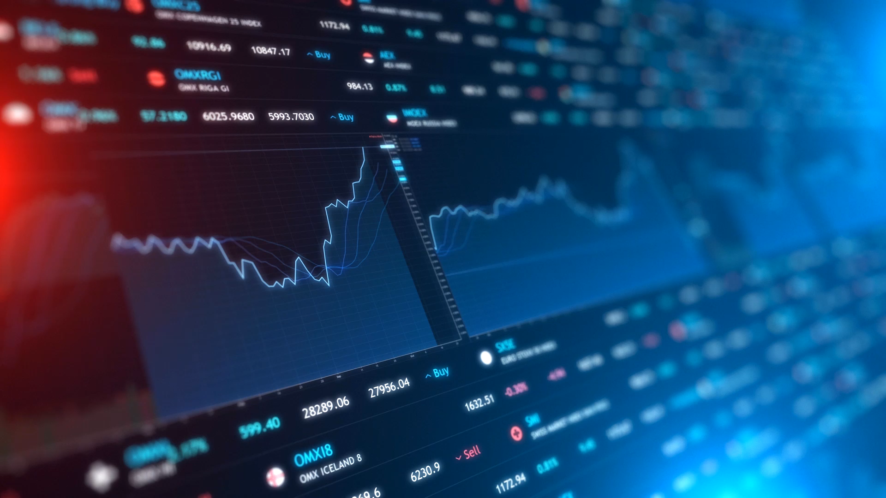
Predicting an Option contracts price
Capstone Project
Data Analytics Boot Camp
The University of Miami
E. Deutsch | D. Perez

Slide 2
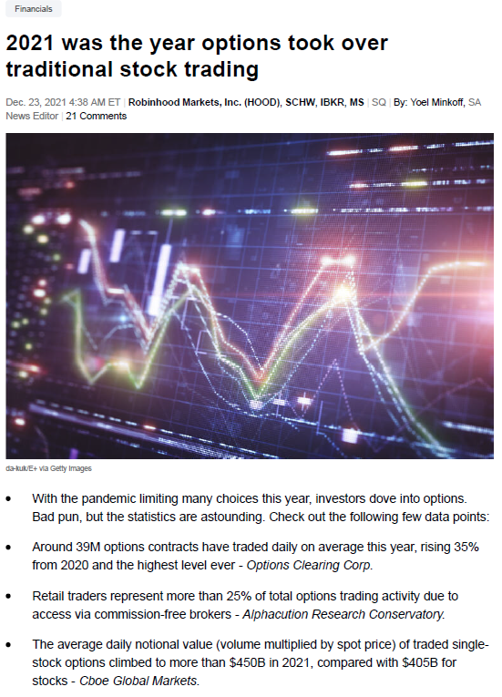
Why this topic?
We have a background in the field of finance
There are an abundance of opportunities in the derivatives market
Data analysis is essential in today’s world, this sector has many opportunities for this
An excellent challenge to apply what we have learned

Slide 3
Overview
Questions we hope to answer with the data
Environment and setup
Description of source data
Pre-Processing
Split/Test/Train
Machine Learning
Post-Processing
Results/Visualization
Recommendation for future analysis
Conclusion

Slide 4
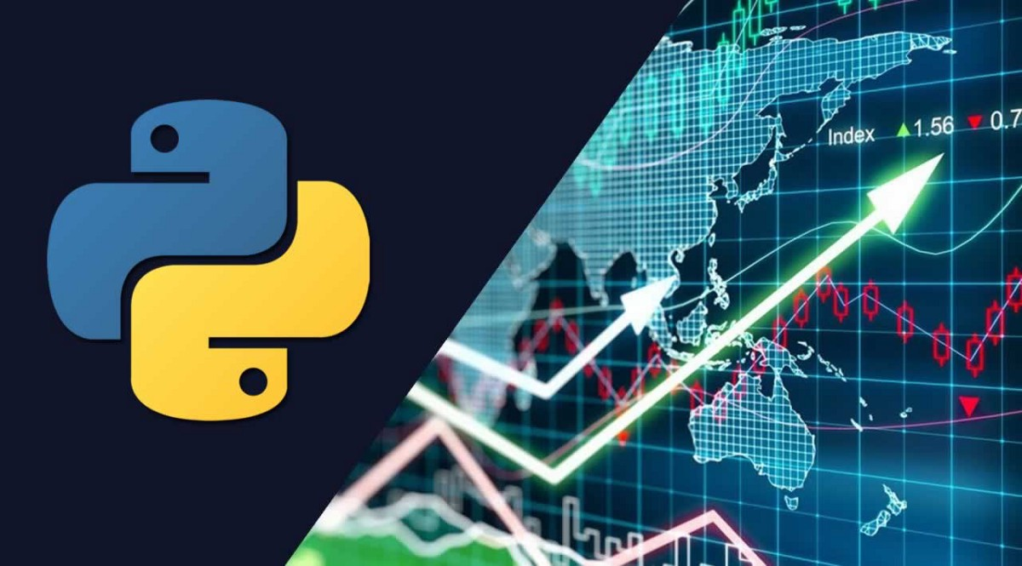
Questions to answer
Are there any correlation between the Contract Price and the features?
What feature(s) has the most significant effect on the predicted Contract Price?
What feature(s) has the least significant effect on the Contract Price?
What could we have done differently to get better results?
What is the Predicted Price for each contract?
What do we recommend for future analysis?
Notes:
Review the questions and see which should be changed… or as we complete the project we come back and update the questions we actually answered throughout the project

Slide 5
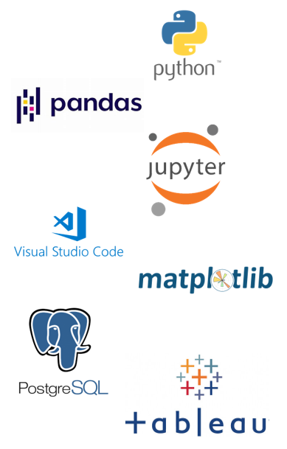
Environment and Setup
Python
Pandas
Jupyter Notebooks
VS Code
Matplotlib
PostgreSQL
Tableau
Notes:
Waiting to see if we need more Logo’s to be included if not this is done

Slide 6
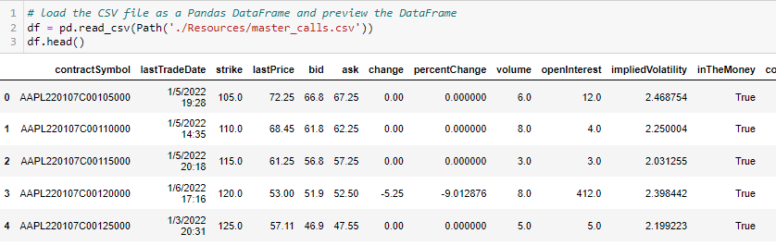
Data Source Description
Obtained through yfinance library
Objective is to predict the contract price within the stocks of the DOW30.
Notes:
Possibly add Test/Train

Slide 7
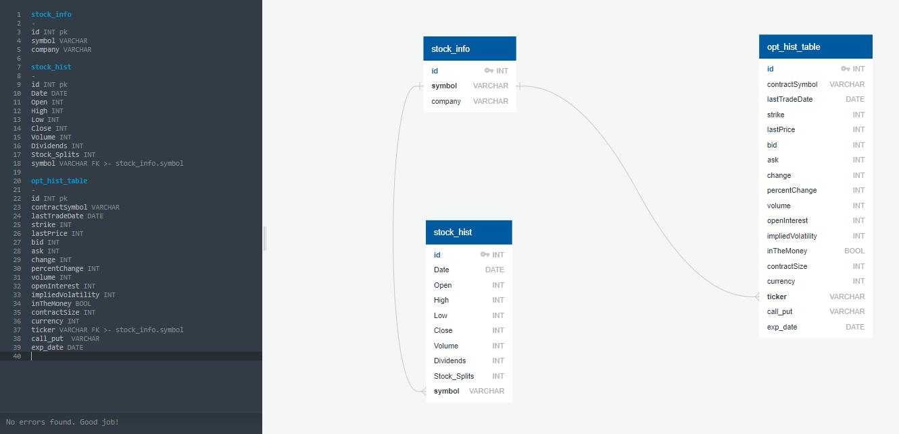
PostgreSQL Database
DB Schema
Notes:
Connecting Pandas to Postgres

Slide 8
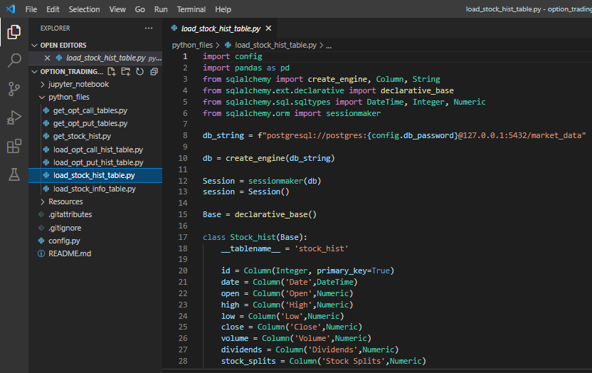
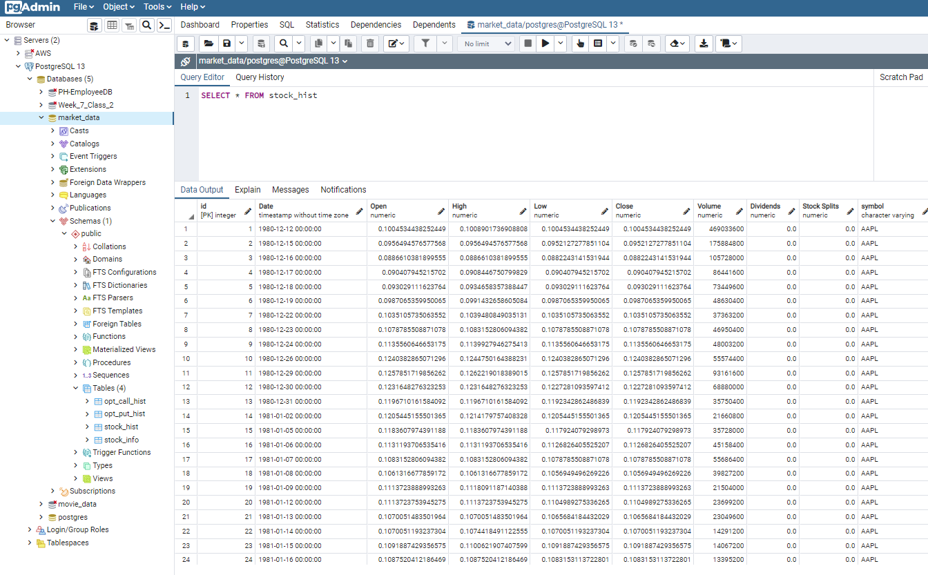
PostgreSQL Database
Sqlalchemy to postgresQL
PostgresQL DB and Tables
Notes:
Connecting Pandas to Postgres

Slide 9
Pre-Processing
Researched possible machine learning models
Focused on multiple linear regression and random forest
Agreed on general project scope
Desired outcomes
Tools
Technologies

Slide 10
Split/Test/Train
Notes:
THIS SLIDE NEEDS TO BE 100% Editted…
It shows the imports they used which will be replaced with ours
Title should also be different

Slide 11
Machine Learning
Notes:
Segment 2 Submission Conducted Clean Up
Narrowed the Data Set
Uploaded Clean Data
Ran Correlation Analysis?

Slide 12
Post-Processing
Notes:
After Scaling and normalization

Slide 13
Results/Visualization
Notes:
Actual Price
Targeted MLR
MLR Complete

Slide 14
Recommendation for future analysis
Notes:
Review at end of project Obtain historical daily option chain history data to set up better sampling parameters
Look into factors affecting our model results with Random Forest
Perform further statistical analysis on more features……..
Increase knowledge of statistics principles

Slide 15
Conclusion
Questions we hope to answer with the data
Environment and setup
Description of source data
Pre-Processing
Split/Test/Train
Machine Learning
Post-Processing
Results/Visualization
Recommendation for future analysis
Conclusion
Notes:
Data analytics is an integral part of almost every industry today. These days It is hard to think of an industry in which Data Analytics does not play a major role. The options market
The use of options allows the investor to trade the market’s “third dimension”. Options allow the investor to trade not only stock movements but also the passage of time and movements in volatility. Most stocks don't have large moves most of the time. Only a few stocks actually move significantly, and they do it rarely. Your ability to take advantage of stagnation could turn out to be the factor deciding whether your financial goals are reached, or they remain simply a pipe dream. Only options offer the strategic alternatives necessary to profit in every type of market.

